Slide 1

Vaibhav Dixit
Neelam Sambnani
Aaryan
Mohit Namdev

Slide 2
Content
BUY
Introduction
Objective Of the Project
Approach
Stock Performance Year Wise
Top Contributing Companies
Working of Web Page
SELL

Slide 3
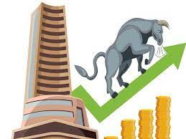
What is Nifty 50
Nifty 50 is a stock market index in India, which comprises the top 50 large-cap companies listed on the National Stock Exchange (NSE). The index is computed using the free-float market capitalization methodology, which takes into consideration only those shares that are available for trading in the market and not held by promoters, governments or associated entities.
The index is widely used as a benchmark to measure the performance of the Indian equity market and is one of the most actively traded indices in India.

Slide 4
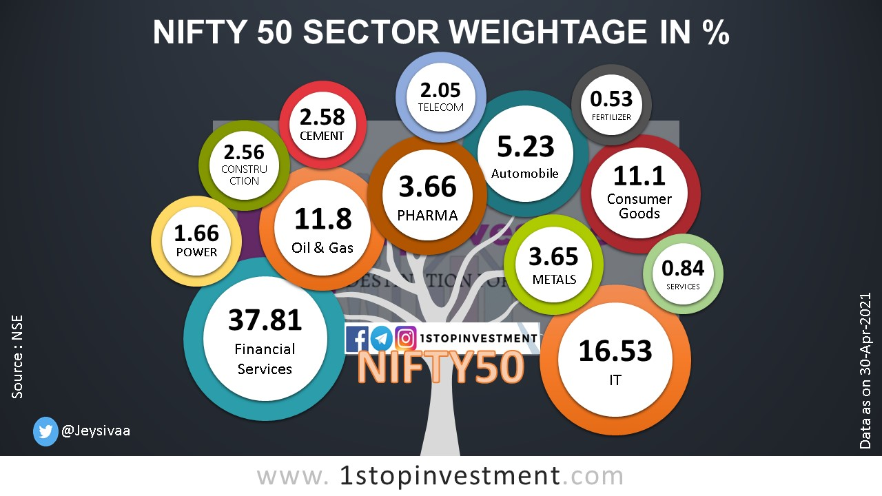
PowerPoint Presentation
Modern PowerPoint
Simple Presentation
PowerPoint
PPT

Slide 5
Objective Of the Project
Objective Of the Project
To Predict the Different Stock Price using Machine Learning.
Calculate the overall returns on their portfolio using web page . User will give all the input in the web page and the final output should be populated in the web page itself.
P
R
O
F
I
T
I
L
O
S
S
K

Slide 6
Our Approach For Project
1
2
3
4
Model Building
Web Page Creation
Data Scraping
We have Created a web page by using Flask ,HTML.
Data Cleaning
Retrieved Data Using Beautiful-Soup from NSE.
. We have created a Model using Linear Regression
Cleaning is done using Python

Slide 7
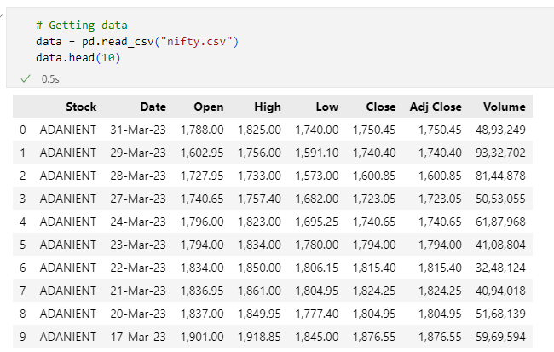
Data Scraping
Dataset scraping done with BeautifulSoup, requests, numpy, pandas and csv module
Stock, Open, Close and Volume are useful out of all columns where Close is target and other columns are feature

Slide 8
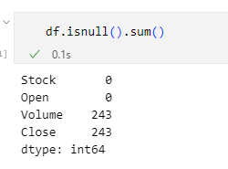
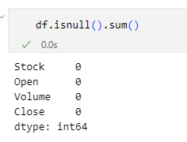
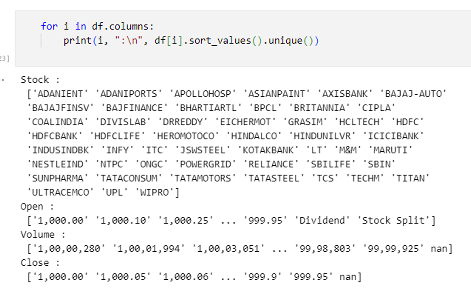
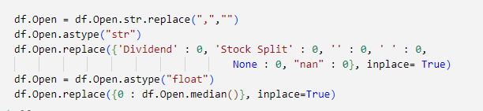
Data Cleaning
Used - replace and median for removing error

Slide 9
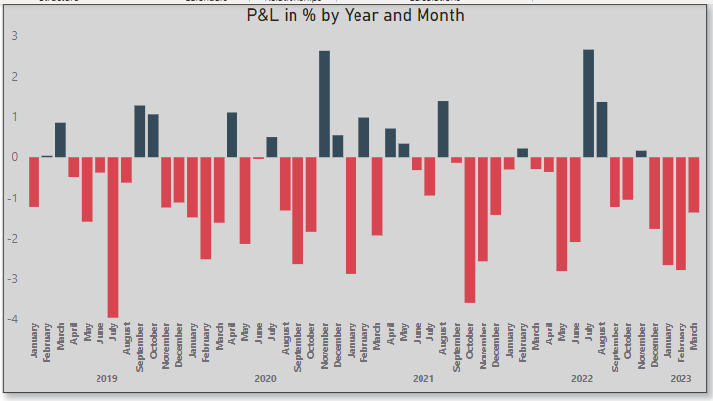
Stock Performance Year Wise
Most Profitable Month is November and Least Profitable is February in all 4 years for Nifty-50.

Slide 10
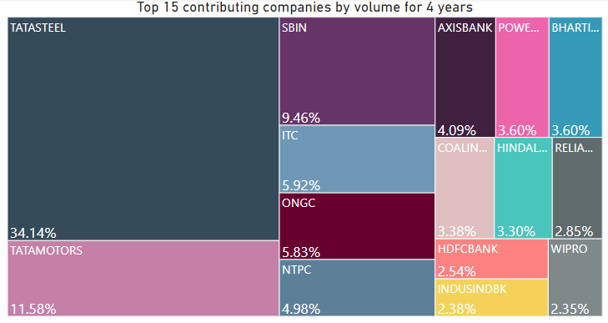
Top Contributing Companies
These are the Top 15 Companies which are continuously Contributing with the most number of shares

Slide 11
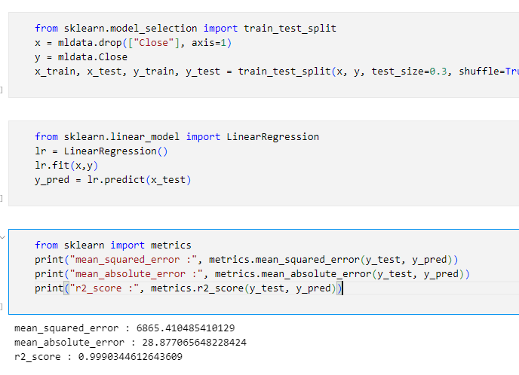
ML Model building
Applied binary encoding on cleaned data
Applied Linear Regression on encoded data

Slide 12
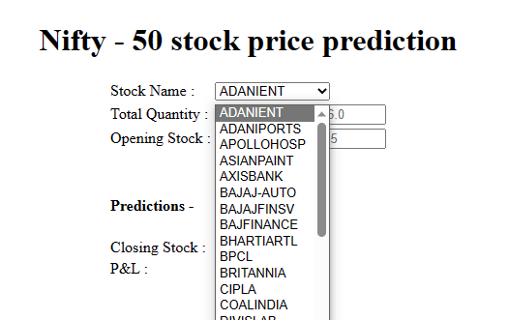
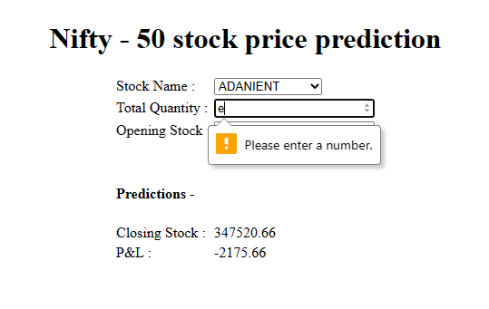
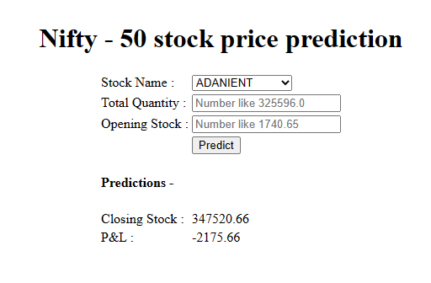
Some Snapshots of Our Web Page

Slide 13
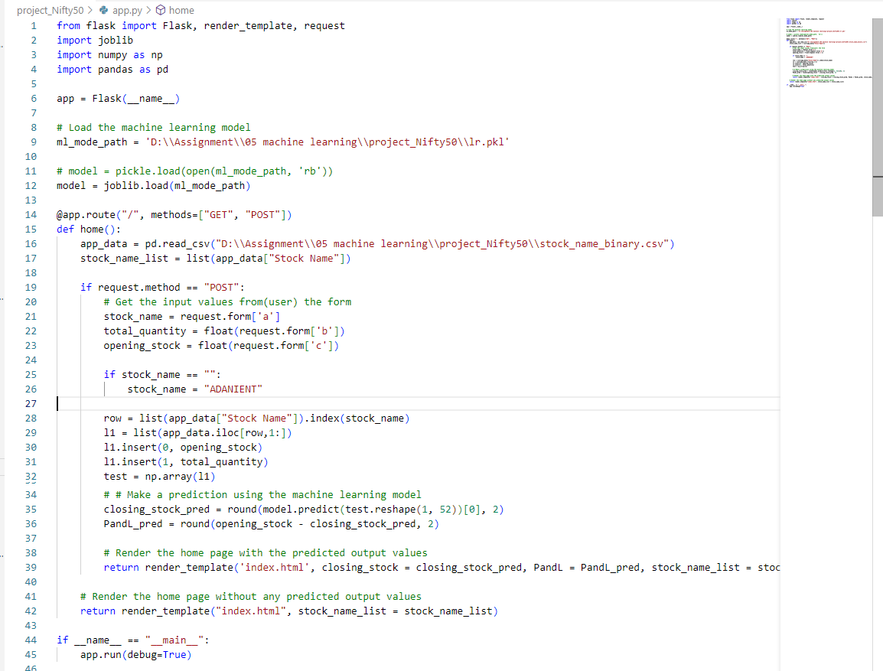
Flask for creating web page with get and post request
get request for user input and post for showing data on web page
Joblib for loading ML model
Numpy for modify user input

Slide 14
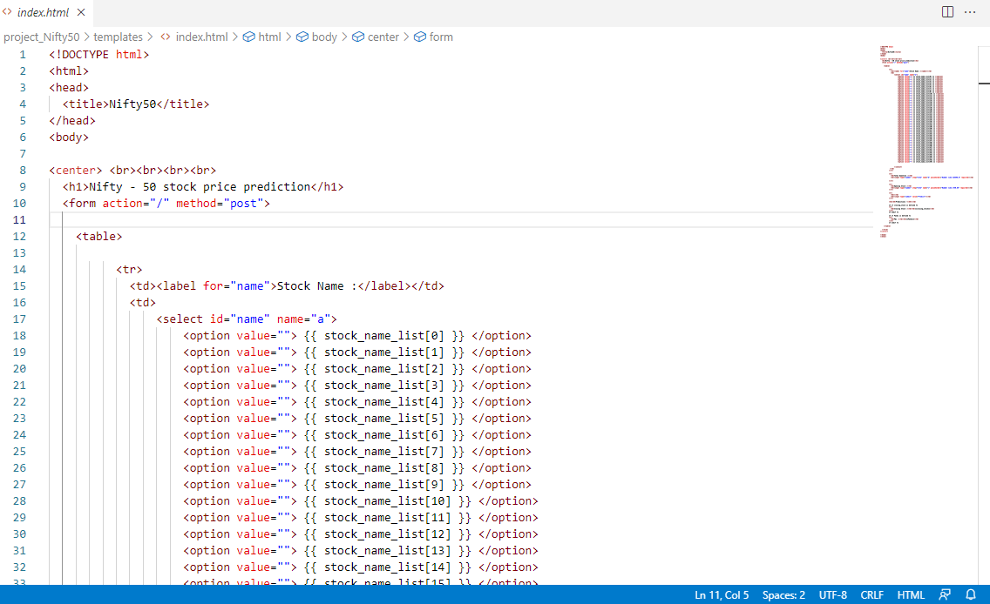

Slide 15


